Slide 1
L4/5 GROUP 13
Amy Potter
Sean Turner
Alex Mednick
Alex Turnbull
Notes:
ALPHA PITCH
Where your game is currently
Iterations as a result of feedback
Usability testing

Slide 2

Market Overview
Two hungry otters compete for the greatest haul of fish whilst sabotaging their opponent.
Platform – Mobile
Casual/mid-core gamers
Female
21-35 age range
AP

Slide 3
The Game
Adversarial
Turn-Based
Symmetrical
AT

Slide 4


What Does the Player Do?
Alternating turns.
Players tap once per turn to reel in.
The next player’s turn begins instantly.
ST
Notes:
Catch fish to increase your score and beat your opponent – watch out for jellyfish!

Slide 5
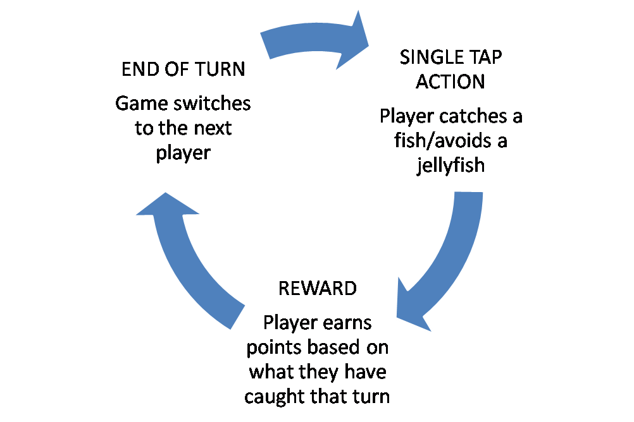
Core Game Loop
ST
Notes:
Catch fish to increase your score and beat your opponent – watch out for jellyfish!

Slide 6



The Challenge
Competition comes from tactics.
People fun.
Offensive and defensive dynamics.
- Catch a fish to score?
- Or reel in early to sabotage opponent?
ST
Notes:
Catch fish to increase your score and beat your opponent – watch out for jellyfish!

Slide 7
The Alpha Build
Alternating reeling-in mechanic
Fish and Jellyfish
Game Timer
Scoring, winning and losing
Power-ups and final art will be implemented next
AM + AT
Notes:
Catch fish to increase your score and beat your opponent – watch out for jellyfish!

Slide 8
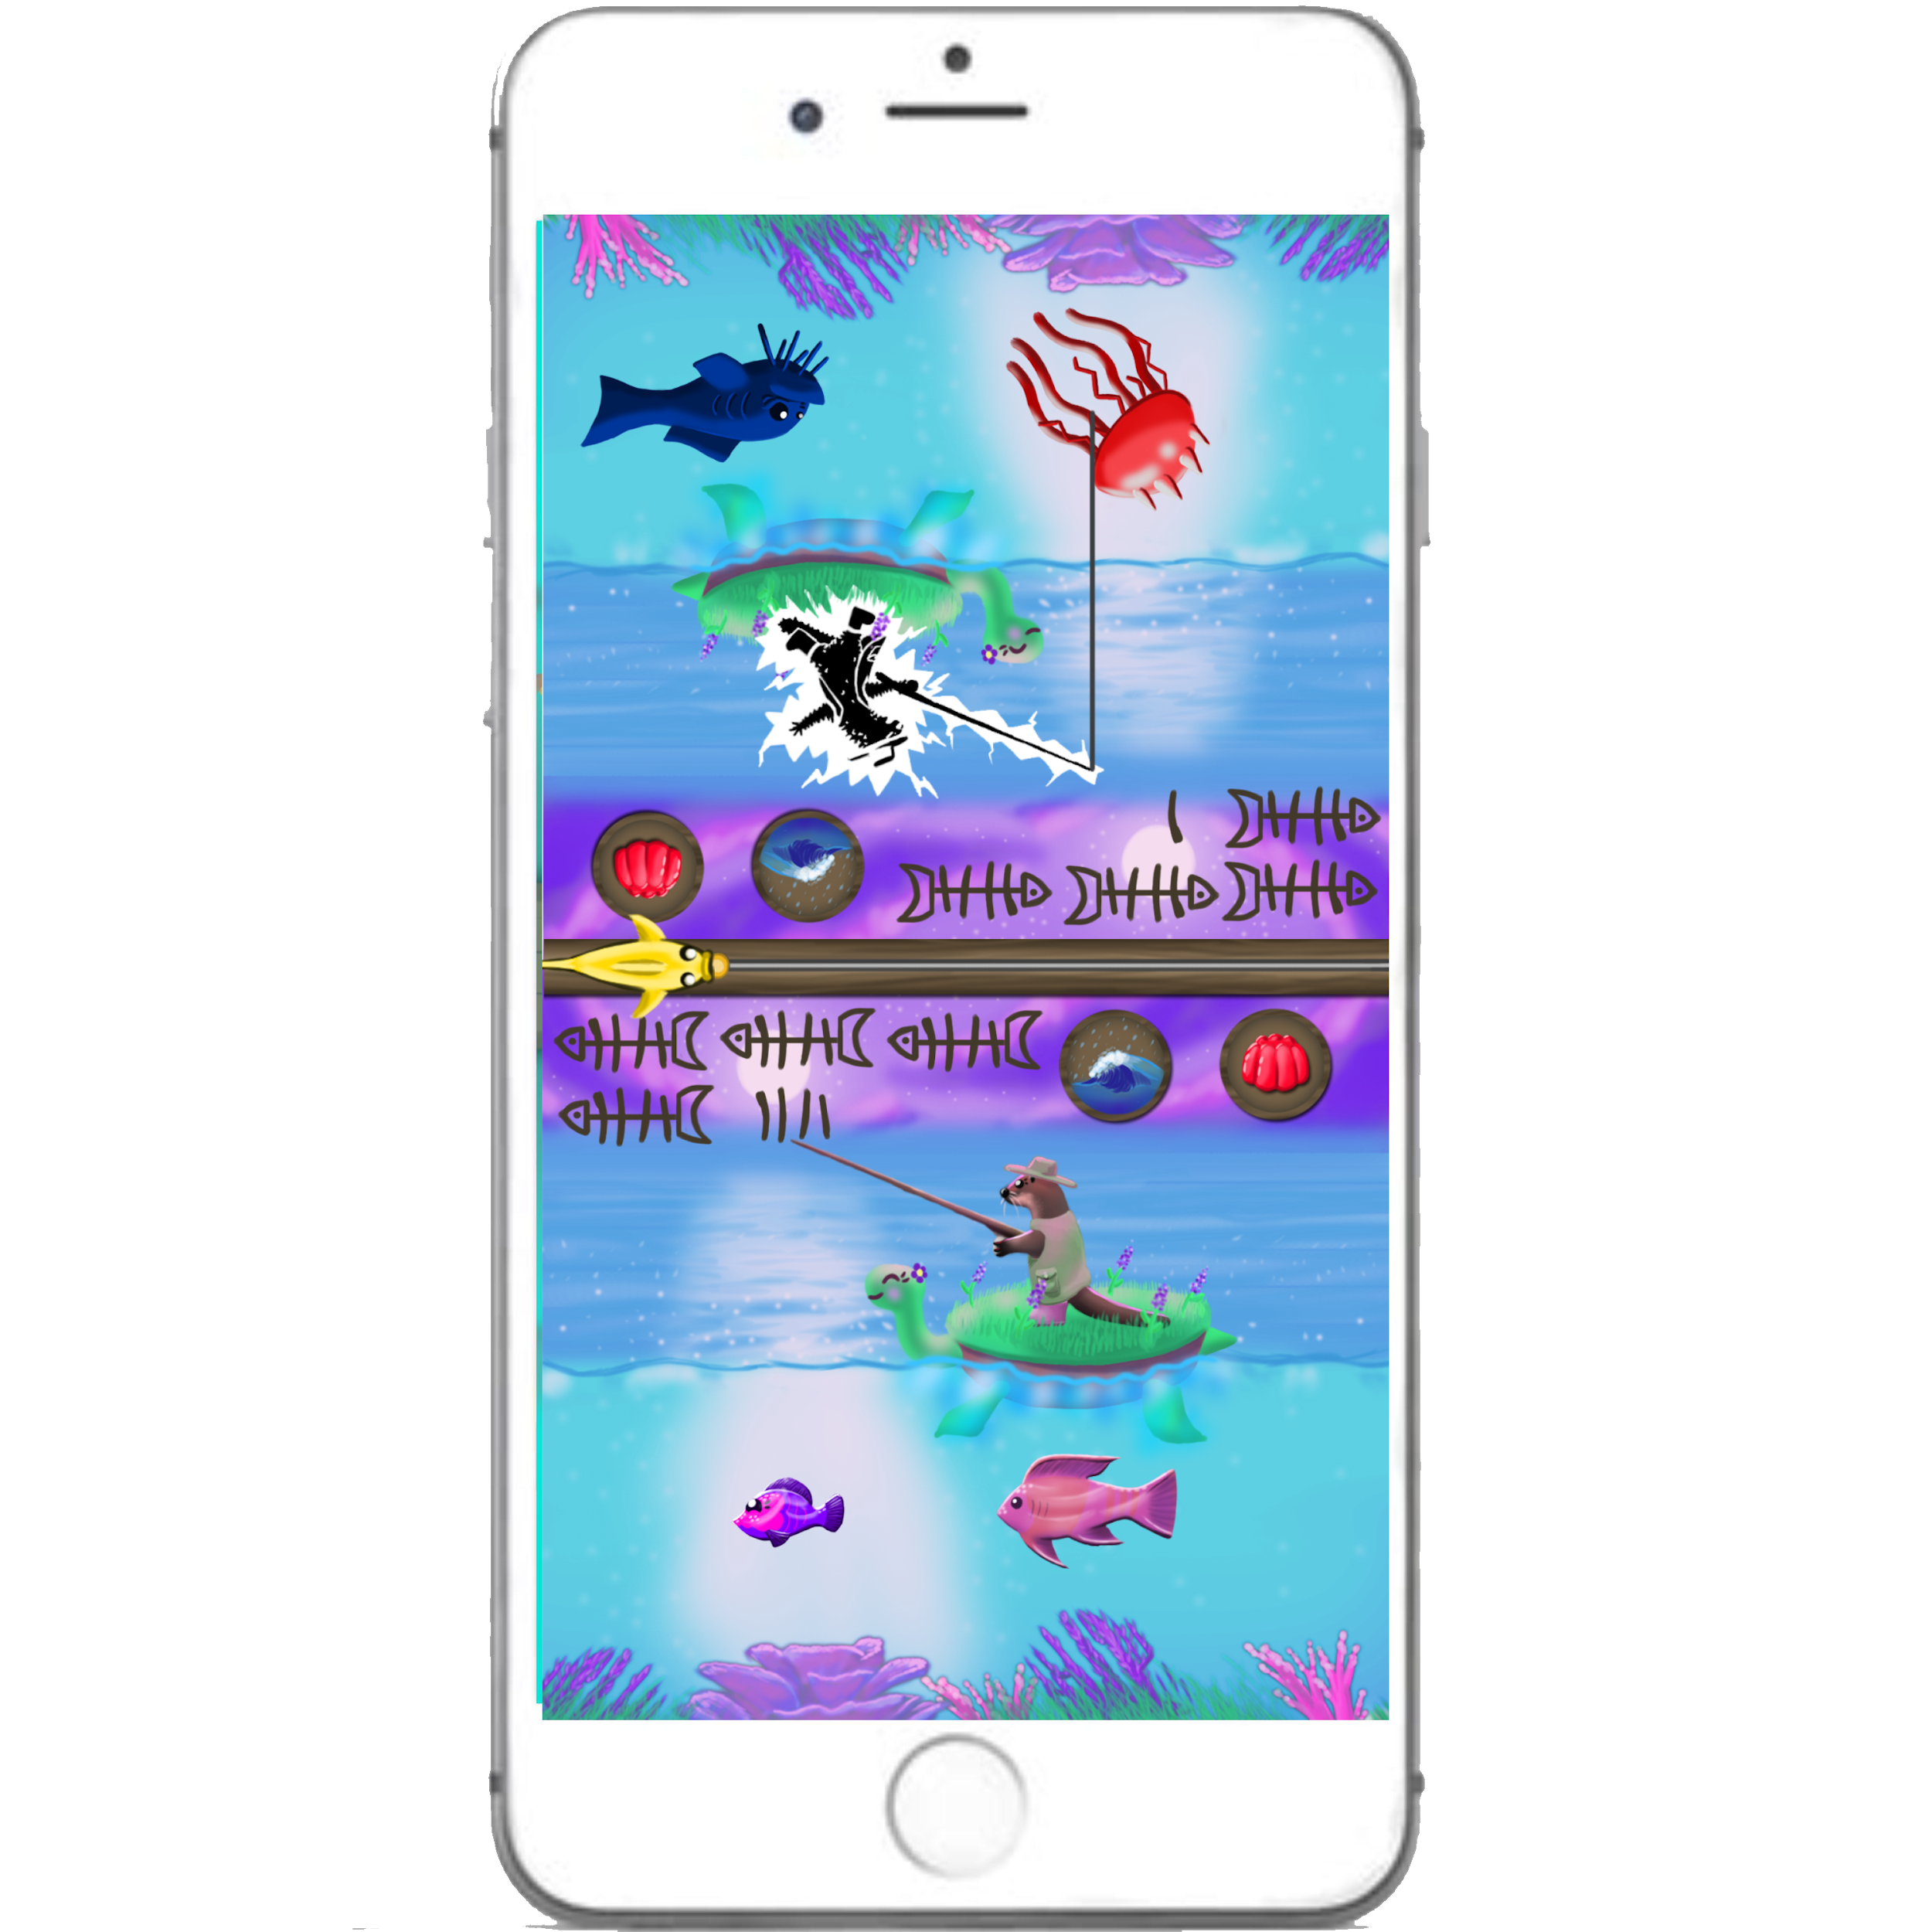
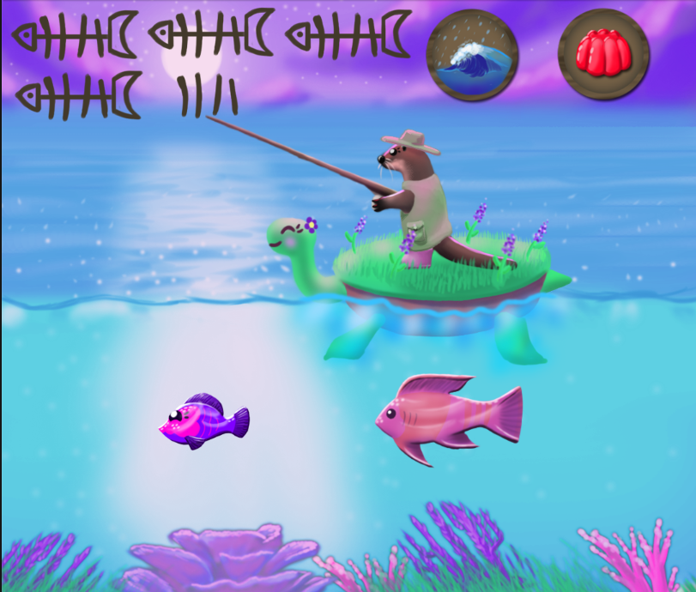
Art Progress
Almost all assets have a final game-ready sprite.
Some (e.g. fish) still need animations.
ST
Notes:
Catch fish to increase your score and beat your opponent – watch out for jellyfish!

Slide 9
Iterations
Power-ups
More visual feedback
Fish move in other direction
Explanation of controls
AP
Notes:
http://developers.magmic.com/demographic-breakdown-casual-mid-core-hard-core-mobile-gamers/
http://www.gamerefinery.com/games-competitive-landscape-categorize/
For the character designs, I have researched popular mobile games on the Google Play Store. I found that animal characters are common, for example in Angry Birds and Toon Blast. They are usually stylised to be cute, or have anthropomorphised features such as clothes. Having a cute main character will also generate emotional empathy in players more easily, as they will want to take care of it.

Slide 10
Management
Hour logged vs sprint total
Amy Potter: 23h 45m/30h
Alex Turnbull: 21h 45m/30h
Alex Mednick: 24h 30m/30h
Sean Turner: 26h 30m/30h
Emails
Amy Potter: 25
Alex Turnbull: 6
Alex Mednick: 11
Sean Turner: 13
AP

Slide 11
Questions?

